Slide 1
Team Henry Presents
Full Circle

Slide 2
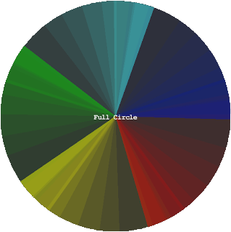
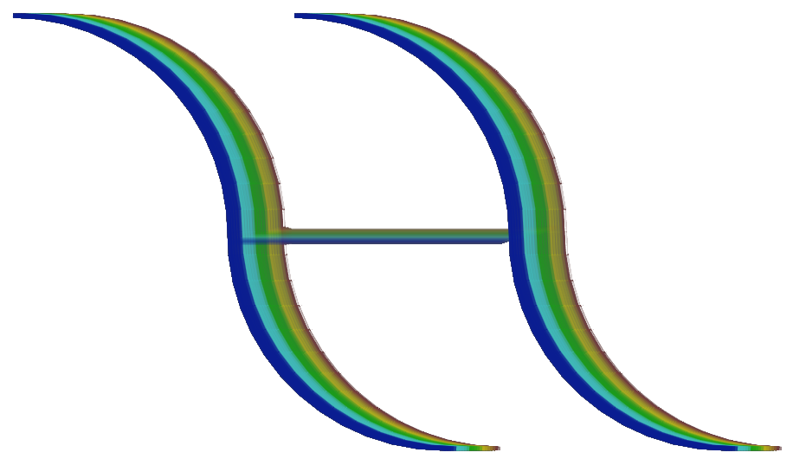
Full Circle (A Team Henry Production)

Slide 3
The Pitch
We are Team Henry
David Anuta, Kyle Sautter, Edward Szczepanski
You can find us at our website:
sites.google.com/site/teamhenryogpc

Slide 4
The Story
1

Slide 5
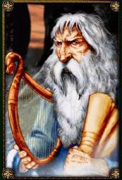
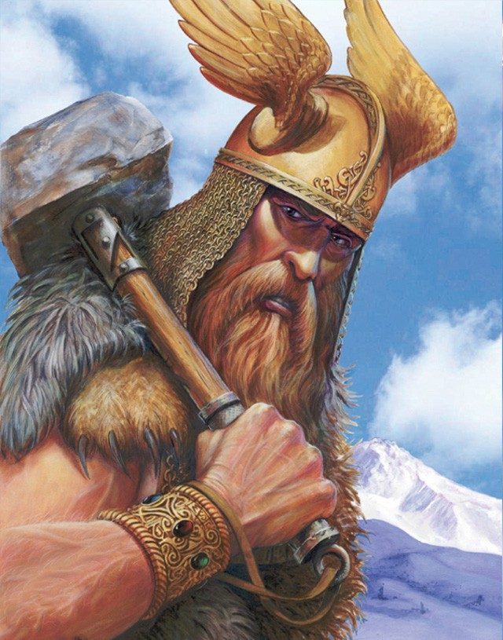
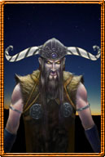
Cast
Bragi
God of music
Basic levels of story
Thor
God of thunder and battle
Introduces a holding mechanic
Loki
God of tricksters
Introduces extra rings

Slide 6
Gameplay
2

Slide 7
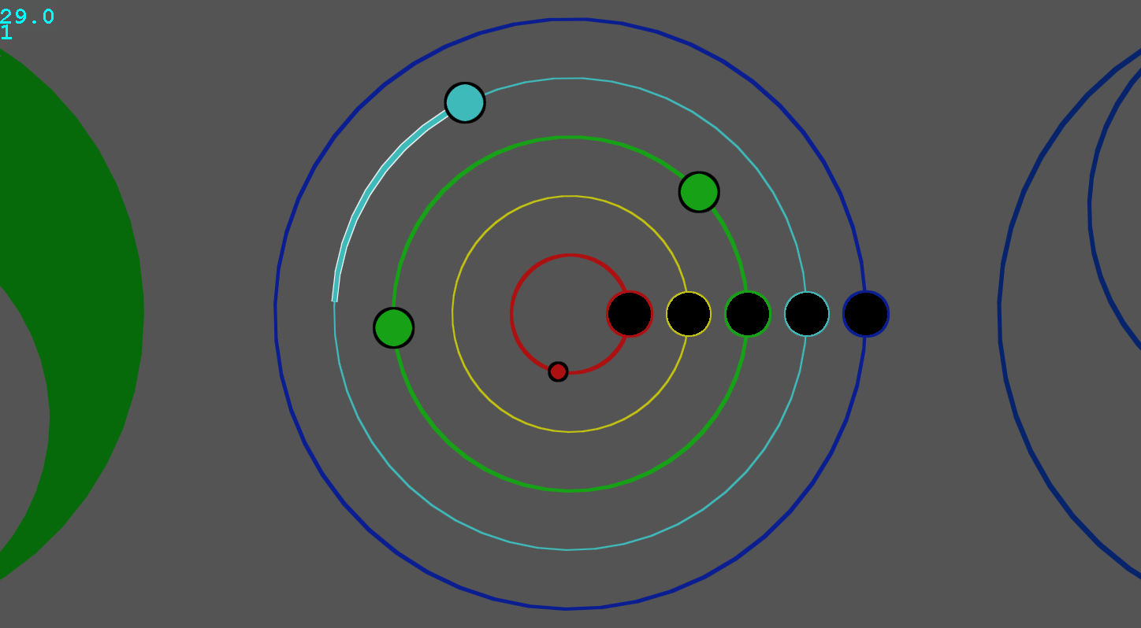

Slide 8
Art and Sound
3

Slide 9
Circle Theme
Trigonometry Based Graphics
Original Animated Story Art

Slide 10
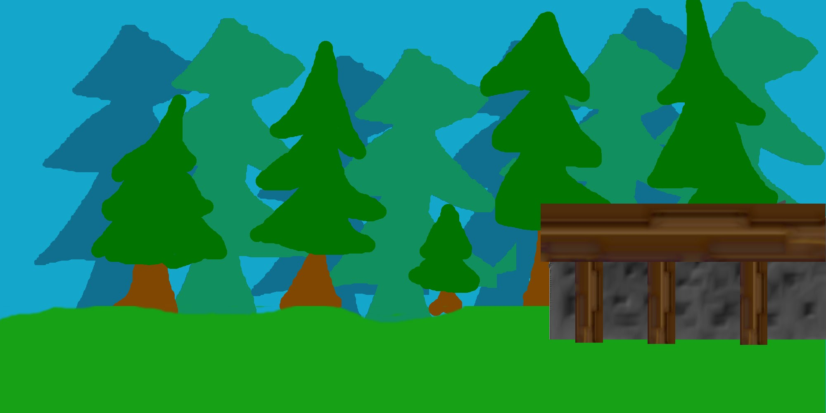

Slide 11
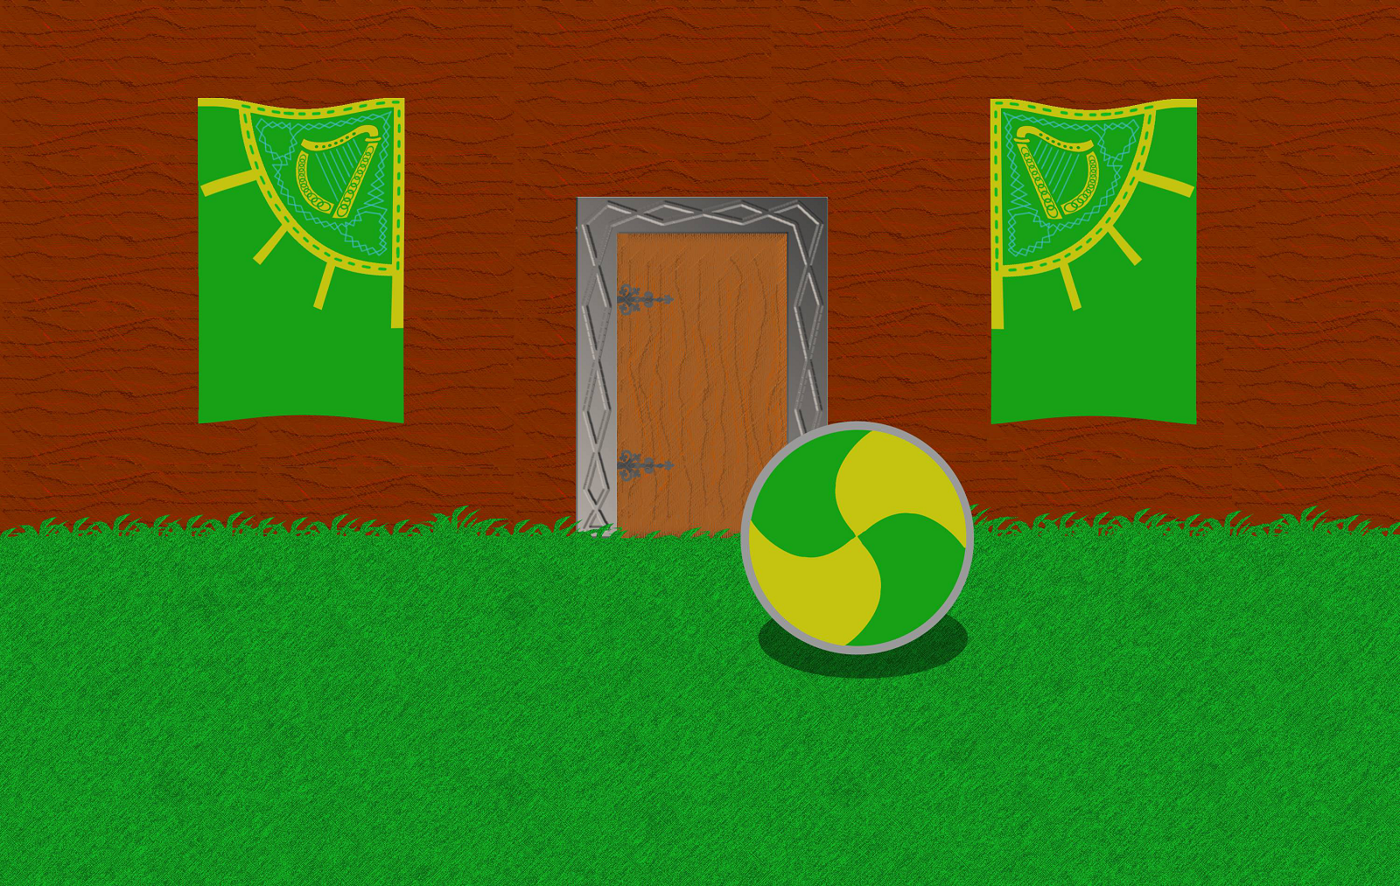

Slide 12
Development
4

Slide 13
Open source (Github, Website)
Built Game Engine (Java, Slick2D)
Control Schemes (Keyboard, Arcade, Dance Pad, Arduino)

Slide 14
Thank You
5

